Slide 1

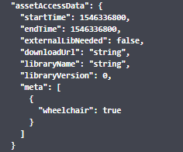
App
1
MP Backend
TO Backend
2
3
4
5
6
lib
7
8
9
10
11
1: app requests opening lock
2: TOMP: POST /legs/{id}/events PREPARE
3: TO response: leg with assetAccessData
4: app gets data
5: app downloads requested library (if not already downloaded)
6: download
7: app calls ‘open’ + argument = assetAccessData.meta
8: lib native implementation Bluetooth opens lock
9: result (code?)
10: app informs backend of result
11: TOMP: POST /legs/{id}/event START
We should extend ‘token’ object with facilities to communicate external library name,
version and download link

